Slide 1
Diode Exercise 2

Slide 2
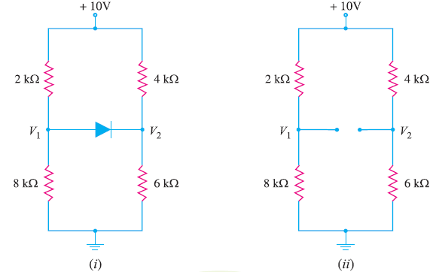
Homework

Slide 3
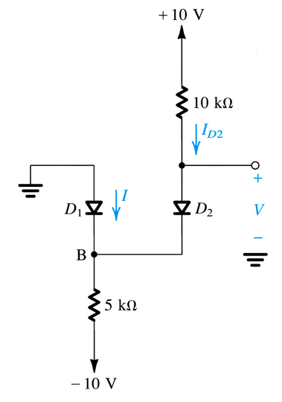
Find V and I with Ideal and Practical Model

Slide 4
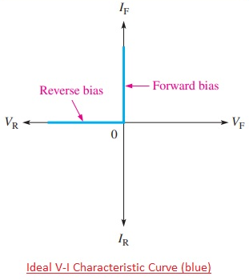
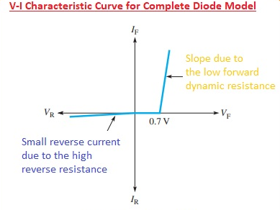
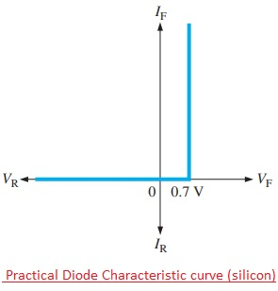
V-I Characteristic: V = f(I)
Q point: A point with specific current and voltage of the diode in a specific circuit analysis

Slide 5
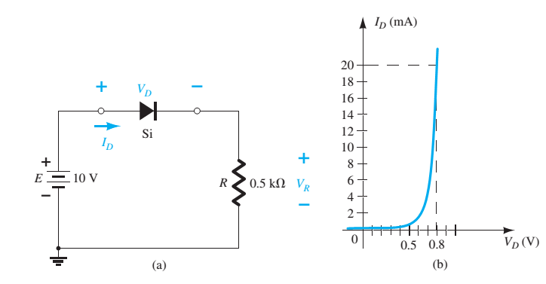
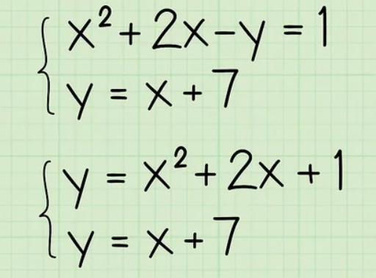
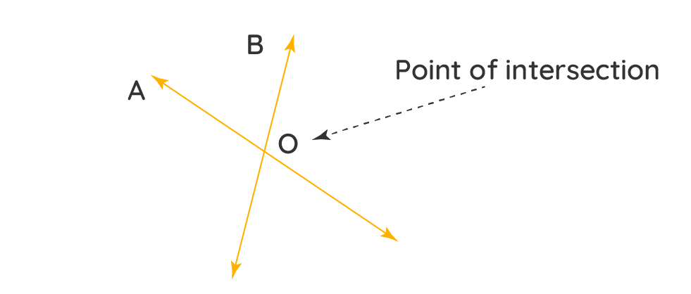
Example for Real V-I Diode
Determine V_{D},I_{D} and V_{R:}
Vd + I*R = E -> Vd = E – I*R -> y = 10 – x*0.5kOhm

Slide 6
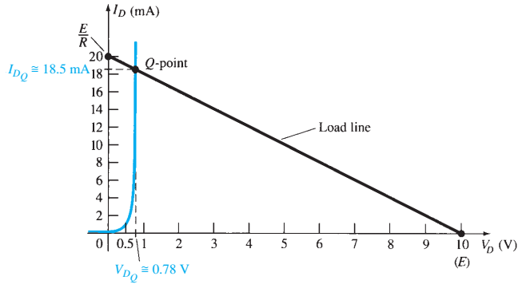
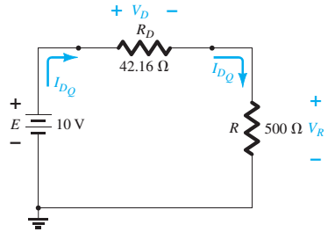
Answer
At Q-point: V_{D}= 0.78V

Slide 7
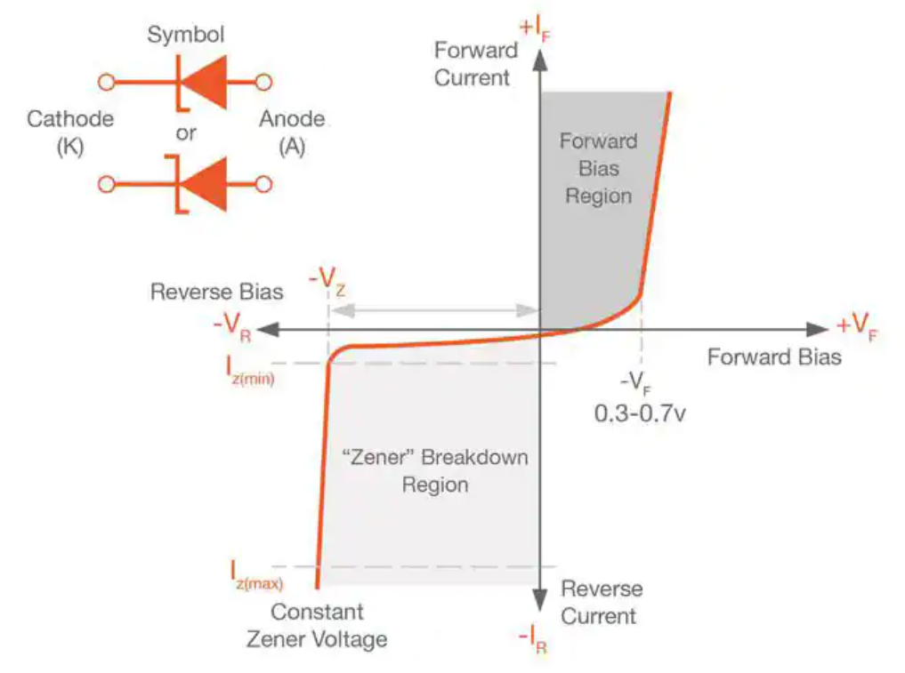
Zener Diode
Forward Bias: Normal diode
Reverse Bias: The voltage is kept at a constant value

Slide 8
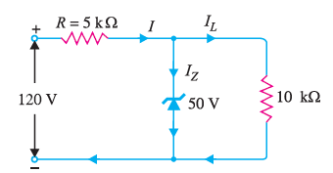
Exercise
Find I and I_{L}

Slide 9
Answer
I = (120-50)/R = 14mA
I_{L} = 50/RL = 50/10k = 5mA
I_{Z} = 14 – 5 = 9mA

Slide 10
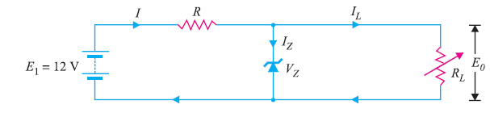
Exercise
The load current is to vary from 12 to 100 mA.
The input voltage is constant at 12V and the minimum zener current is 10 mA.
Find the value of series resistance R to maintain a voltage of 7.2 V across the load.

Slide 11
Answer
VR = 12 – 7.2 = 4.8V
The minimum zener current will occur when the load current is maximum:
R < = 4.8 / (10 + 100)mA = 43.5 OhM

Slide 12
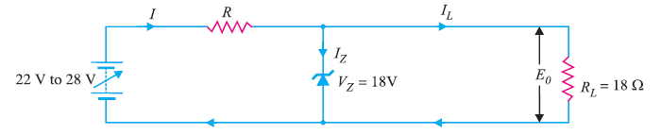
Exercise
The minimum Zener current is 200 mA.
The input voltage is vary from 22V to 28V

Slide 13
Answer
The zener current will be minimum (i.e. 200 mA) when the input voltage is minimum (i.e. 22 V)
IL = 1000mA
R = (22 – 18)/ (200 + 1000) = 3.33 Ohm

Slide 14
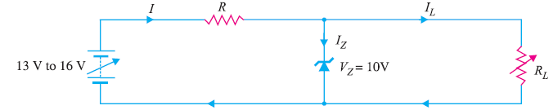
Exercise
The input voltage varies between 13 V and 16 V
The load current varies between 10 mA and 85 mA
The minimum zener current is 15 mA
Calculate the value of series resistance R

Slide 15
Answer
R = 30 Ohm

Slide 16
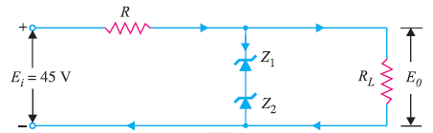
Exercise
Zener is 15V
I_{Z} = 200mA
I_{L} = 100mA
Calculate R?

